Slide 1

Mobile Financial Services (MFS) TV Advertising Campaign Analysis
Topic: Mobile Financial Service (MFS) TV Advertising
Presented by:
Md. Maidul Hassan Shanto

Slide 2
Macro-Market Dynamics: Capital Deployment vs. Airtime Dominance
MFS Brands | Share of Spend | Share of Voice | Media Efficiency Index | Strategic Position
bKash | 73% | 83% | 1.14 (High Efficiency) | Market Leader
DBBL Rocket | 23% | 14% | 0.61 (Low Efficiency) | Top Challenger
Islami Bank | 3% | 2% | 0.67 (Low Efficiency) | Niche Player
The Big Three
bKash dominates the MFS market, turning 73% spend into 83% voice (Efficiency Index: 1.14). DBBL Rocket overpays, with 23% spend generating only 14% voice (Index: 0.61). Islami Bank remains small, 3% spend for 2% voice (Index: 0.67).

Slide 3
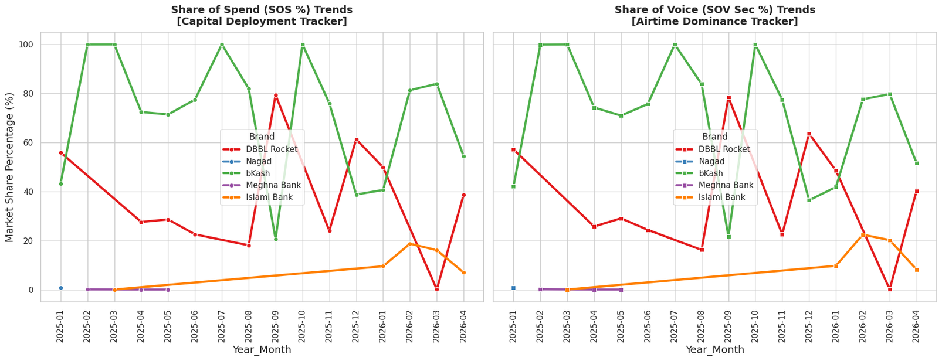
Media Investment vs Visibility Performance
Festive Surge Mechanics
Challenger Premium Penalty
bKash’s Volumetric Efficiency:
March 2025 and 2026 see predictable spikes in MFS TV spending due to the pre-Eid retail rush. Brands compress budgets to maximize transactional wallet share in a short window.
Competitors overpay during these peaks, with SOS% exceeding SOV%, paying more for limited visibility in high-cost, cluttered Prime Time and sports slots.
bKash avoids inefficient spikes, leveraging bulk agency deals to maintain strong baseline voice, ensuring high visibility without overspending.

Slide 4
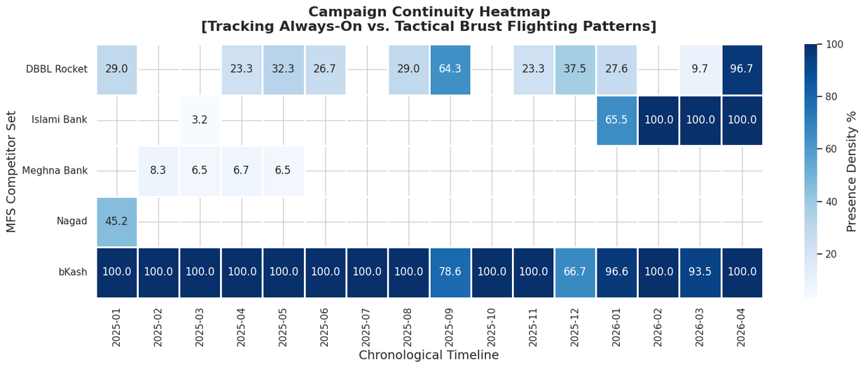
Always-On Media Strategy
Strategic Takeaway for bKash
bKash maintains an always-on presence (90–100%) each quarter, acting as a defensive shield to protect its network and customer base. Competitors go dark off-peak and launch short, concentrated bursts during festive or cricket periods. bKash’s strategy: maintain steady baseline visibility and exploit low-cost off-peak windows rather than reacting to seasonal spikes.

Slide 5
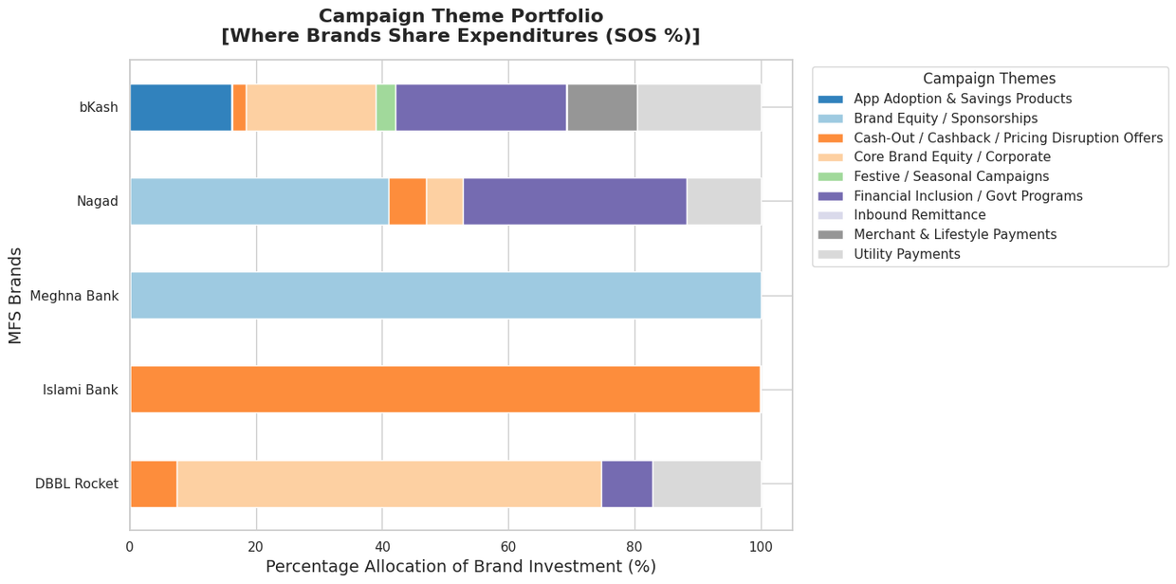
Campaign Messaging Analysis
The Thematic Landscape
bKash spreads media across App Adoption, Utility Bill Payments, and Core Brand Equity, building long-term consumer retention. Competitors focus on short-term “Cash-Out Fee Wars” and seasonal cashback promotions.
Recommendation:
bKash should avoid price-matching and emphasize high-value ecosystem features like remittance, banking partnerships, and merchant coverage where competitors cannot compete.

Slide 6
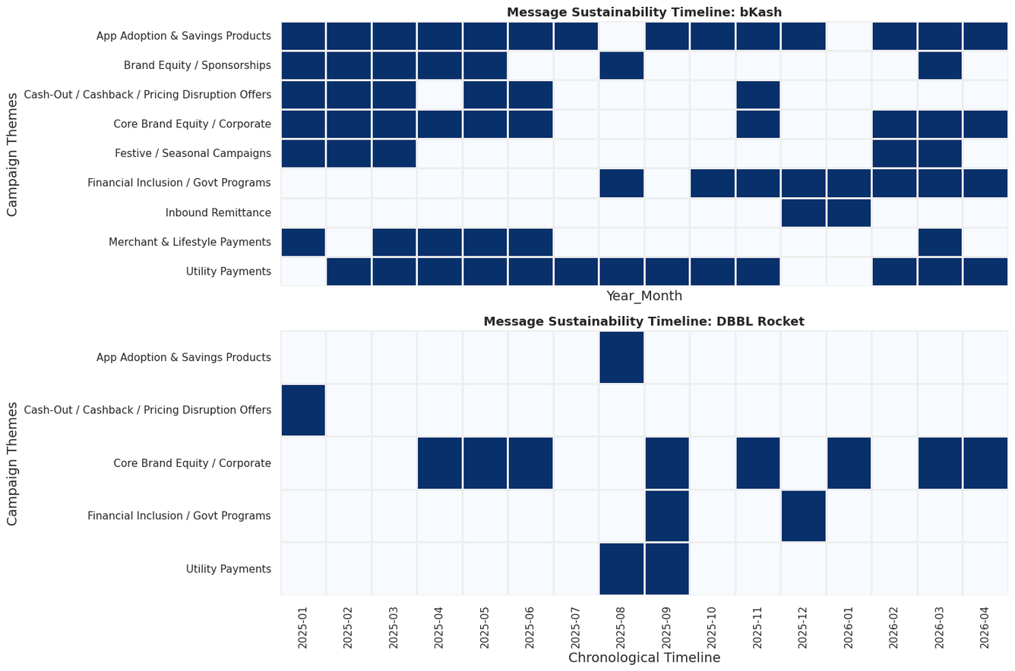
Advertising Timing & Daypart Strategy
Analyzing Chronological Campaign Lifespans
bKash runs continuous campaigns across Utility Bill Payments, Core P2P, and App Ecosystems, building habitual consumer usage. DBBL Rocket keeps a baseline for its tagline but has fragmented deployment for value-added services. Key takeaway: bKash uses TV as an interactive classroom to expand user engagement, while Rocket relies on traditional corporate messaging.

Slide 7
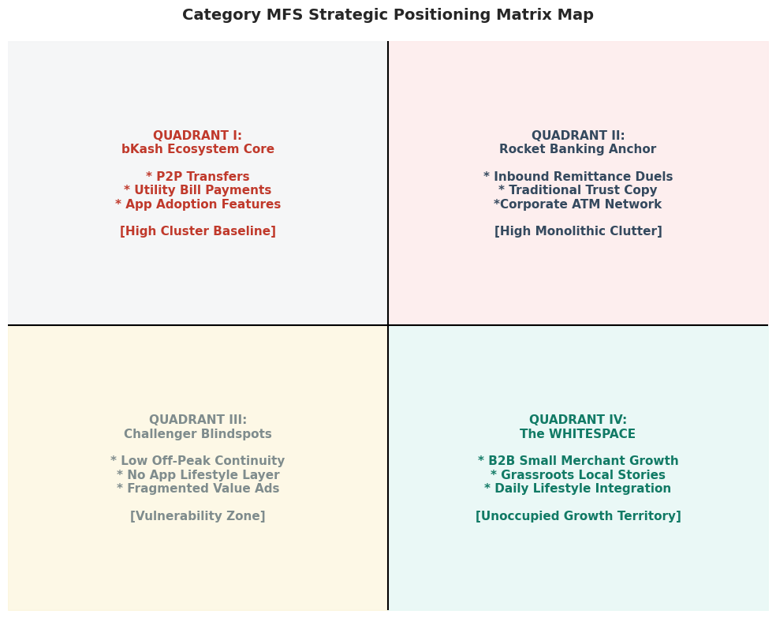
Category Whitespace Mapping: Uncovering Structural Blind Spots
Identify Unoccupied Strategic Fields
bKash is diversified but faces pricing attack risks due to its large footprint.
Two whitespace opportunities exist:
1. B2B Small Merchant Growth : No MFS brand targets retail shopkeepers and micro-entrepreneurs effectively.
(2) Modern Lifestyle Integration: MFS can be framed as a seamless part of daily urban routines, beyond generic cash-out messaging.

Slide 8
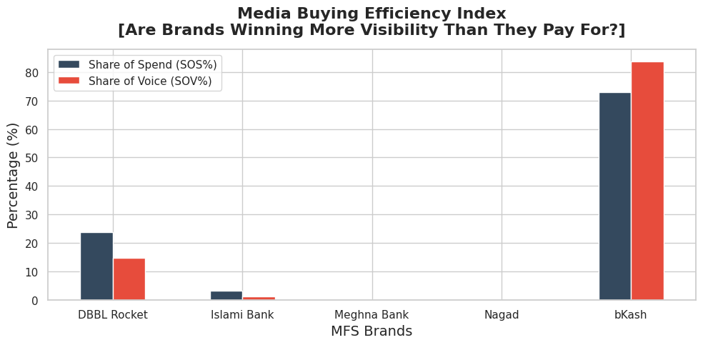
Media Efficiency ROI: Maximizing Share of Voice per Taka Expended
The Strategic Spread Between Category
bKash achieves high media efficiency, with SOV% exceeding SOS%, leveraging volume scale for maximum attention. Competitors overpay, especially during festive or cricket spikes, reducing ROI.
Key takeaway: sustained, year-round media anchors drive true dominance, not reactive budget spikes.

Slide 9
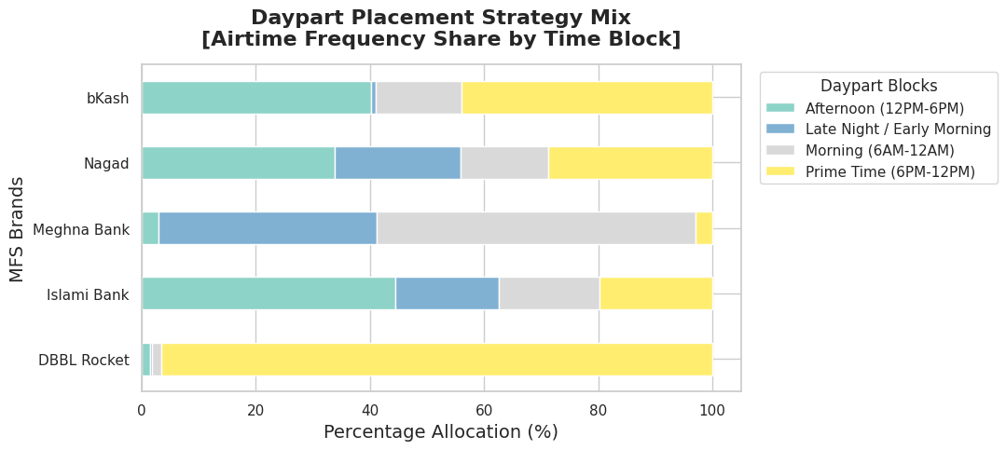
Daypart Strategy: Balancing Off-Peak Reach with Prime-Time Clutter
Deconstructing Time-Block Frequency
bKash spreads ad frequency across Morning and Afternoon slots, capturing attentive off-peak audiences like homemakers and local merchants efficiently. Competitors over-index on congested Prime Time (6–12PM), paying higher rates and reducing frequency efficiency.
Key insight: bKash builds daily usage habits, while challengers rely on high-impact, short-term corporate messaging.

Slide 10
Future Campaign Planning & Smarter Timing
Pre-Peak Flighting Pivot
Payday Capture Windows
Counter-Cyclical Continuity
Shift 15% of festive budget to 14–20 days before major cycles to secure prime spots at standard rates, avoiding end-of-Ramadan congestion.
Schedule high-utility app features (bill payments, remittance) between the 28th and 5th to align with payroll liquidity, ensuring maximum transactional engagement.
Maintain a low-cost, always-on baseline during off-peak periods when competitors are dark, securing high Share of Voice at reduced cost.

Slide 11
Competitive Positioning & Messaging Guardrails
Refuse the Pricing Bait
Ecosystem Interconnectivity as a Moat
bKash should avoid engaging in low-charge or cashback-matching ads on TV. Doing so would commoditize the MFS category and validate competitor price wars, wasting premium airtime.
Focus messaging on features that competitors cannot easily replicate, such as seamless bank-to-wallet/wallet-to-bank transfers, interest-bearing savings and micro-insurance, and the extensive retail merchant network. This positions bKash as an integrated, daily lifestyle platform rather than just a transactional tool.

Slide 12
Media Deployment Optimization
30s-10s Asset Split Rule
70/30 Tactical vs. Long-Term Balance
Launch new campaigns with a 30-second story-driven ad to create engagement, then shift 80% of remaining spots to 10-second reminders. This maximizes Share of Voice (SOV%) while keeping costs (SOS%) low.
Allocate 70% of budget to always-on campaigns for core app features, security, and merchant ecosystem. Reserve 30% for tactical bursts during high-velocity periods (pre-Eid, Boishakh) targeting seasonal transactions like merchant cashback and remittance.

Slide 13
conclusion
bKash’s leadership stems from superior media strategy, always-on continuity, and a multi-pillar messaging approach. It’s not just about high spending. Competitors overpay for temporary prime-time visibility, while bKash blends evening impact with cost-effective daytime reach.
Key roadmap: avoid price wars, apply the 30s-10s asset split, and target B2B merchants and urban lifestyle whitespaces to secure long-term category dominance.

Slide 14
Thank you
@reallygreatsite

